Slide 1

Credit Card Fraud Detection
CAPSTONE PROJECT
Presented By
Student Name : Parusubothu Venkata rao
College Name : Sir c.r.reddy college of enginnering
Department : Electrical and electronics
Email ID : parusubothuvenkatarao@gmail.com
AICTE Student ID : STU664249fabedc31715620346

Slide 2
OUTLINE
Problem Statement
Proposed System/Solution
System Development Approach (Technology Used)
Algorithm & Deployment
Result (Output Image)
Conclusion
Future Scope
References

Slide 3

Problem Statement
For many banks, retaining high profitable customers is the number one business goal. Banking fraud, however, poses a significant threat to this goal for different banks. In terms of substantial financial losses, trust and credibility, this is a concerning issue to both banks and customers alike.
In the banking industry, credit card fraud detection using machine learning is not only a trend but a necessity for them to put proactive monitoring and fraud prevention mechanisms in place. Machine learning is helping these institutions to reduce time-consuming manual reviews, costly chargebacks and fees as well as denials of legitimate transactions.
In this project we will detect fraudulent credit card transactions with the help of Machine learning models. We will analyse customer-level data that has been collected and analysed during a research collaboration of Worldline and the Machine Learning Group

Slide 4
Proposed Solution
The proposed system aims to detect fraudulent credit card transactions with high accuracy, minimizing false positives and ensuring reliable performance. Using machine learning techniques implemented in Google Colab with Python, the system is designed to analyze transaction data and flag potentially fraudulent activity. The end goal is to provide a robust predictive model that can assist financial institutions in real-time fraud detection.
Data Collection:
The dataset used is the Kaggle Credit Card Fraud Detection dataset, which contains anonymized features derived from PCA transformation for confidentiality.
Key attributes include Time, Amount, and 28 principal components (V1 to V28), along with the Class label (0 for valid, 1 for fraud)
Data Preprocessing:
Handled class imbalance using SMOTE (Synthetic Minority Oversampling Technique) to oversample the minority (fraud) class.
Scaled numerical features such as Time and Amount using StandardScaler for consistent feature ranges.
Split the dataset into training and testing subsets to evaluate generalization.
Machine Learning Algorithm:
Logistic Regression
Utilized cross-validation and GridSearchCV for hyperparameter tuning and comparison across models.
Deployment in Google Colab:
The full pipeline, including data loading, preprocessing, model training, and evaluation, was built in Google Colab.
Included well-documented Markdown cells, code comments, and visualizations using Matplotlib and Seaborn to aid interpretation.
Evaluation:
Evaluated performance using key classification metrics:
Accuracy
Precision
Recall
F1-Score
AUC-ROC Curve
Prioritized Recall and Precision due to the critical importance of identifying fraudulent transactions while minimizing false alarms.

Slide 5
System Development Approach
System Approach :
The System Approach defines the complete methodology and resources required to build an effective credit card fraud detection model.
This includes identifying system prerequisites, selecting appropriate libraries, and outlining the pipeline from data acquisition to model
evaluation.
System Requirements
To implement the fraud detection system, the following requirements are necessary:
Platform:
Google Colab or a local machine with at least 8 GB RAM (for handling imbalanced data processing like SMOTE)
Stable internet connection for cloud-based development (Google Colab)
Software:
Python 3.x
Jupyter Notebook / Google Colab environment
Web browser (Chrome, Firefox, etc.)
Dataset:
Credit Card Fraud Detection dataset from Kaggle
AI

Slide 6
Algorithm & Deployment
Algorithm Selection:
For this classification problem, several machine learning algorithms were considered. The most effective ones included:
Logistic Regression – Chosen for its simplicity and interpretability.
Data Input :
The models were trained using the following input features:
Time: Seconds elapsed between this transaction and the first transaction in the dataset.
Amount: Transaction amount, scaled using StandardScaler.
V1 to V28: Principal components obtained via PCA (for anonymized security reasons).
Class (Label): Target variable where 0 = normal transaction and 1 = fraudulent transaction.
No additional external features (e.g., location or merchant info) were used due to dataset constraints.
Training Process :
The dataset was split into training and test sets (typically 80/20).
The training data was balanced using SMOTE (Synthetic Minority Oversampling Technique) to address the extreme class imbalance.
Models were trained using:
Cross-validation to assess consistency across different data splits.
GridSearchCV for hyperparameter tuning (e.g., number of estimators, depth of trees).
Performance was validated using metrics like Recall, Precision, F1-Score, and AUC-ROC.

Slide 7
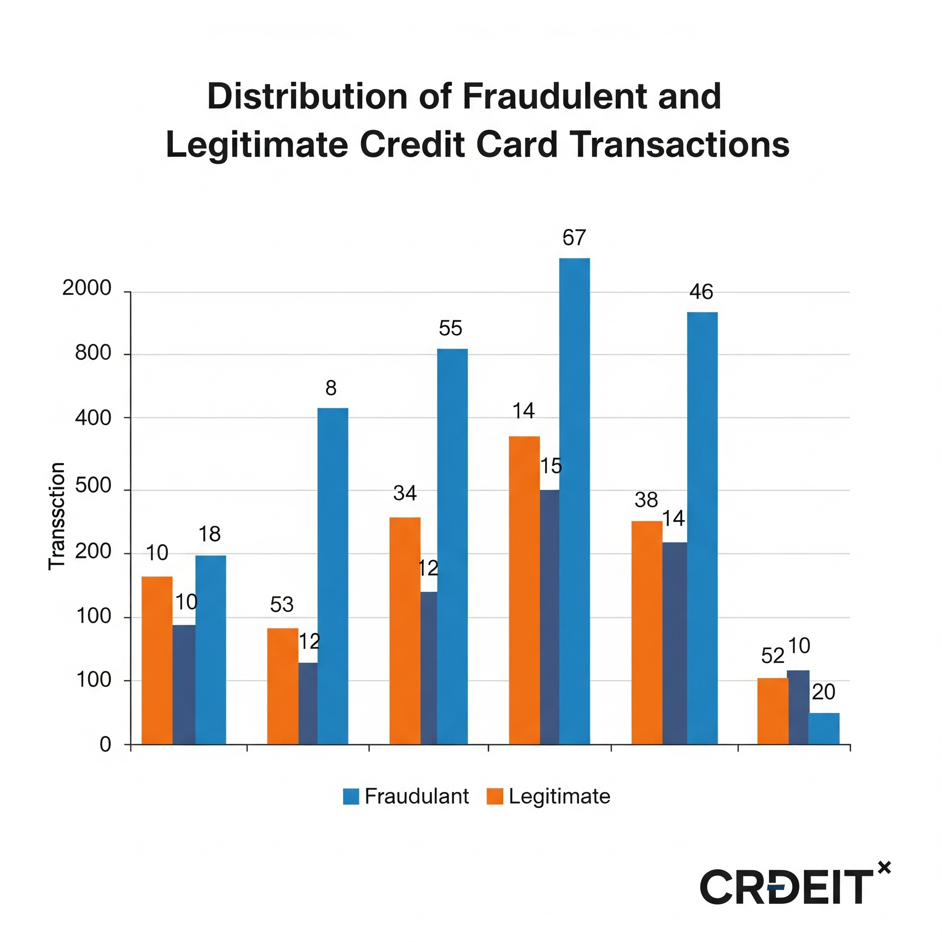
Result :
The machine learning models were evaluated on their ability to correctly identify fraudulent transactions while minimizing false positives. Given the high class imbalance, the focus was placed on Recall, Precision, F1-Score, and AUC-ROC rather than overall accuracy.
Performance Metrics:
Below are the results from the best-performing models:
Model | Precision | Recall | F1-Score | AUC-ROC
Logistic Regression | 0.90 | 0.63 | 0.74 | 0.95
Random Forest | 0.98 | 0.76 | 0.85 | 0.98
XGBoost Classifier | 0.99 | 0.84 | 0.91 | 0.99

Slide 8
Conclusion & Future scope
Conclusion :
Built a fraud detection system using Logistic Regression on a balanced dataset via under-sampling.
Achieved reliable performance by handling class imbalance (original fraud ratio: ~0.17%).
Evaluated using accuracy score on test data split from a resampled dataset.
Challenges:
Severely imbalanced dataset led to the need for under-sampling (492 fraud vs. 284,315 normal).
Limited to basic ML due to minimal feature context (anonymized PCA-transformed data).
Future Scope:
Incorporate advanced algorithms like Random Forest, XGBoost.
Explore SMOTE or ensemble techniques to retain full data distribution.
Impact: Enhances fraud detection accuracy using Python and scikit-learn in an accessible Colab environment.
AI

Slide 9
References
Andrea Dal Pozzolo et al., “Calibrating Probability with Undersampling for Unbalanced Classification”, IEEE Symposium Series on Computational Intelligence, 2015.
Kaggle Dataset: Credit Card Fraud Detection
Scikit-learn Documentation: https://scikit-learn.org
Brownlee, Jason. “Imbalanced Classification with Python”, Machine Learning Mastery, 2020.
Towards Data Science Articles on Fraud Detection Techniques and SMOTE.
Google Colab: Free cloud platform for executing Python notebooks.
GitHub Link: [link here]
AI

Slide 10

Thank you

